Slide 1
BIRTH OF RAILWAYS AND THEIR IMPACT ON ECONOMIC & SOCIAL GEOGRAPHY + DEVELOPMENT OF RAILWAY NETWORKS EMERGENCE OF DIVERSE SYSTEM
NAIR – 16th SEPTEMBER 2014
BIMSTEC PROGRAMME

Slide 2
THIS SESSION
BIRTH OF RAILWAYS IN UK
THE US EXPERIENCE
SOUTH AMERICA
INDIAN EXPERIENCE
RAILWAYS IN SOME SMALLER COUNTRIES
ISSUES FACING RAILWAYS TODAY
RAILWAY REVIVAL

Slide 3
BIRTH OF RAILWAYS IN U.K.

Slide 4
RAILWAY DEVELOPMENT IN UK
1825 STOCKTON TO DARLINGTON LINE
1830 MANCHESTER TO LIVERPOOL LINE
1838 500 MILES – 5 ½ MILLION PASSENGERS
1844-46 RAILWAY MANIA-LARGE SCALE PROJECTS
1839-53 SIX GOVT. COMMITTEES ON RAILWAYS
OVER 100 RAILWAY COMPANIES

Slide 5
BENEFITS OF RAILWAY DEVELOPMENT IN BRITAIN
GROWTH OF THE ECONOMY
Absorbed Capital Investment
Generated Demand from other industries
Cheaper and large scale transportation of Goods
EXPANSION OF COAL INDUSTRY
GROWTH OF TOWNS
Railways met demand for food items meat, flour etc.
Building Material / Raw Material for industry
BOOST TO NATIONAL ECONOMY
Change over from Local to National Market

Slide 6
BENEFITS OF RAILWAY DEVELOPMENT IN BRITAIN
GROWTH IN EMPLOYMENT
By 1911 3% of Labour Force on the Railways
Creation of Jobs in Mining, metallurgy & other areas
PROMOTION OF TRAVEL
Suburban Travel to Work
Changing pattern in rural life
Development of Leisure Resorts
Impact on Politics
OTHER ASPECTS
Newspapers
Movement of Perishables: Milk, Meat, Vegetables, Fish

Slide 7
RAILROADS IN THE USA

Slide 8
RAILROAD DEVELOPMENT IN THE USA
1830 FIRST SECTION BALTIMORE & OHIO RAILWAY
1831 MOHAWK & HUDSON – COMMON CARRIER
1850 - 1400 Km OF RAILWAY HAD BEEN BUILT
1869 THE FIRST TRANS CONTINENTAL LINE BY UNION PACIFIC & CENTRAL PACIFIC RAILWAYS
1887 INTERSTATE COMMERCE COMMISSION
1890 SHERMAN ANTITRUST ACT TO CHECK AGAINST MONOPOLIES

Slide 9
ECONOMIC BENEFITS OF RAILROADS IN USA
ENABLED WHITE SETTLERS TO POPULATE THE WEST
RAPID GROWTH OF NEW FARMLANDS
RAILWAYS HELPED THE ‘TAKE OFF’ OF INDUSTRIALIZATION - REDUCTION IN TRANSPORT COSTS, NEW PRODUCTS & EXPAND MARKETS
GENERATED NEW INVESTMENTS AND STRENGTHENED FINANCIAL MARKETS
SOME ECONOMISTS FEEL CONTRIBUTION OF RAILWAYS WAS LESS THAN WHAT WAS THE CONVENTIONAL VIEW

Slide 10
DEVELOPMENTS IN SOUTH AMERICA

Slide 11
GROWTH OF RAILWAY MILEAGE IN SOME LATIN AMERICAN COUNTRIES
 | 1890 | 1900 | 1912
ARGENTINA | 9254 | 16767 | 32212
BRAZIL | 9973 | 15316 | 23491
MEXICO | 9718 | 13585 | 20447
CHILE | 2747 | 4354 | 7260
CUBA | 1731 | 1960 | 3803

Slide 12
BENEFITS IN LATIN AMERICA TO ECONOMY
STUDIES REVEAL THAT THOSE LATIN AMERICAN COUNTRIES THAT INVESTED HEAVILY IN RAILWAYS OBTAINED BETTER BENEFITS THAN EUROPEAN & NORTH AMERICAN ECONOMIES
IN CASE OF DIRECT CONTRIBUTION OF RAILWAYS TO PRODUCTIVITY GROWTH IN CASE OF ARGENTINA & MEXICO DIRECT BENEFITS WERE 20% TO 25% OF TOTAL GROWTH IN INCOME PER CAPITA

Slide 13
INDIAN EXPERIENCE

Slide 14
INDIAN EXPERIENCE
FIRST TRAIN APRIL 1853
INVESTMENT BY PRIVATE COMPANIES
STRONG GOVERNMENT CONTROL
LARGE NUMBER OF COMPANIES
GIP, EIR, BB&CI, O&RR, BNR, NWR, MADRAS RAILWAY, SIR, RMR
PRINCELY STATE RAILWAYS e.g. Nizam’s State Railway
GOVERNMENT ALSO CONSTRUCTED LINES
RAPID GROWTH OF NETWORK ALL OVER INDIA

Slide 15
INDIAN RAILWAYS 1911

Slide 16
MAIN OBJECTIVES OF RAILWAY CONSTRUCTION IN INDIA
TO FACILITATE BETTER ADMINISTRATIVE CONTROL OVER A LARGE COUNTRY
TO ENABLE LARGE SCALE EXPORTS FROM INDIA – COTTON, WHEAT, INDIGO THROUGH BOMBAY, MADRAS & CALCUTTA
TO ENABLE IMPORTS OF TEXTILES AND FINISHED PRODUCTS
A STRATEGIC ASSET FOR PROTECTION OF ITS FRONTIERS PARTICULARLY THE NORTH WEST

Slide 17
PHASES IN FINANCING & MANAGEMENT OF INDIAN RAILWAYS
1849-1861 CLASSIC GUARANTEE PHASE
1862 – 1867 UNAIDED COMPANIES
1868 – 1880 STATE ENTERPRISE
1881-1900 PRIVATE & PUBLIC ENTERPRISE
1900 – 1914 STATE FINANCED CONSTRUCTION

Slide 18
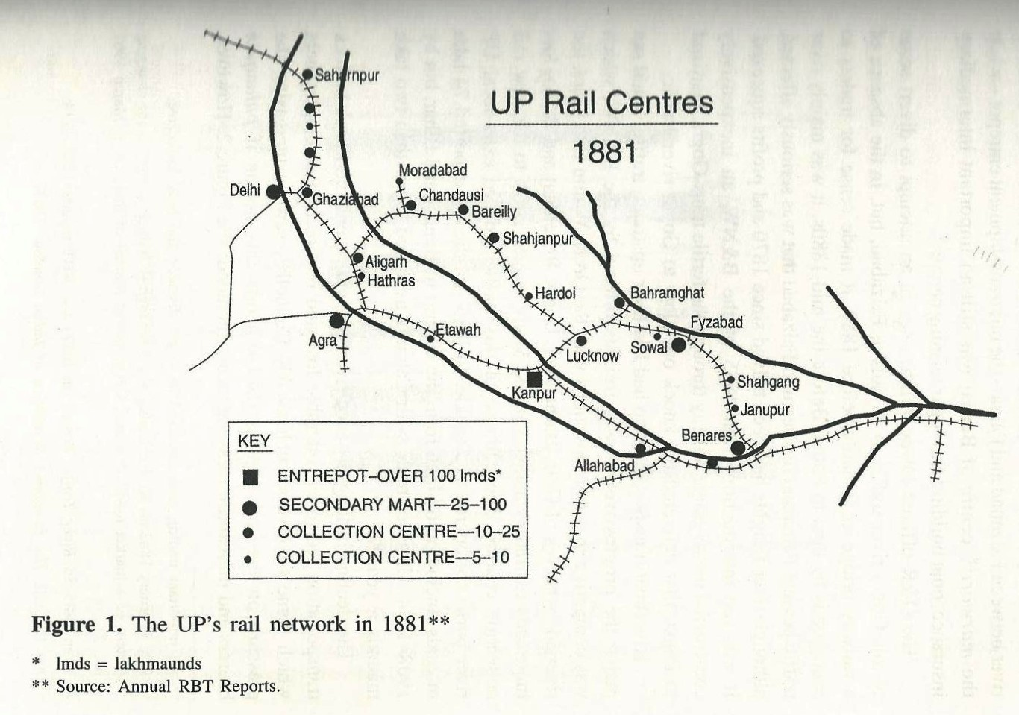
RAIL NETWORK IN UNITED PROVINCES IN 1881

Slide 19
RAIL BORNE TRADE IN UNITED PROVINCES 1880-1914
YEAR | EXPORTS | EXPORT COMMODITIES | IMPORTS | IMPORT COMMODITIES | TOTAL
1880-84 | 198 | (WHEAT, | 177 | (GRAIN & | 375
1885-89 | 237 | OTH. GRAIN, | 204 | COAL) | 442
1890-94 | 283 | SUGAR | 270 |  | 553
1895-99 | 333 | COTTON & | 337 |  | 671
1900-04 | 497 | OIL SEED) | 345 |  | 843
1905-09 | 382 |  | 526 |  | 908
1910-14 | 611 |  | 678 |  | 1289
Figures: Annual Average in ’00,000 Maunds

Slide 20
EMPLOYMENT IN TRANSPORTATION IN UNITED PROVINCES

Slide 21
ALL INDIA AVERAGE RAILWAY RATES 1865-1915 (IN PIES)
YEAR | PER PASSENGER MILE | PER MAUND MILE
1865 | 3.50 | 0.40
1875 | 3.50 | 0.33
1885 | 2.52 | 0.25
1895 | 2.49 | 0.23
1905 | 2.47 | 0.19
1915 | 2.44 | 0.16

Slide 22
SOME ISSUES WHICH IMPACTED EARLY COMMERCIAL GROWTH
ROUTING POLICIES
COMMERCIAL PERFORMANCE
RATING POLICIES
EFFICIENCY IMPROVEMENT
FUEL ECONOMY
REDUCTION OF LABOUR COSTS
OPERATIONAL EFFICIENCY

Slide 23
CONTRIBUTION OF RAILWAYS TO INDIA
IN PRE INDEPENDENT INDIA
INTERNATIONAL TRADE
CREATION OF A NATIONAL MARKET SOME PRICE CONVERSION
CONVENIENT TRAVEL
NO INDUSTRIALIZATION
POST INDEPENDENCE
RAPID GROWTH OF INDUSTRIALIZATION
NATIONAL INTEGRATION (OFTEN UNDER-ESTIMATED)
GROWTH IN MOBILITY
RAILWAYS FINDING IT DIFFICULT TO KEEP PACE WITH DEMAAND

Slide 24
GROWTH IN FREIGHT TRAFFIC

Slide 25
GROWTH IN ORIGINATING PASSENGERS IN MILLIONS

Slide 26
THE MIDDLE EAST - HEDJAZ RAILWAY

Slide 27
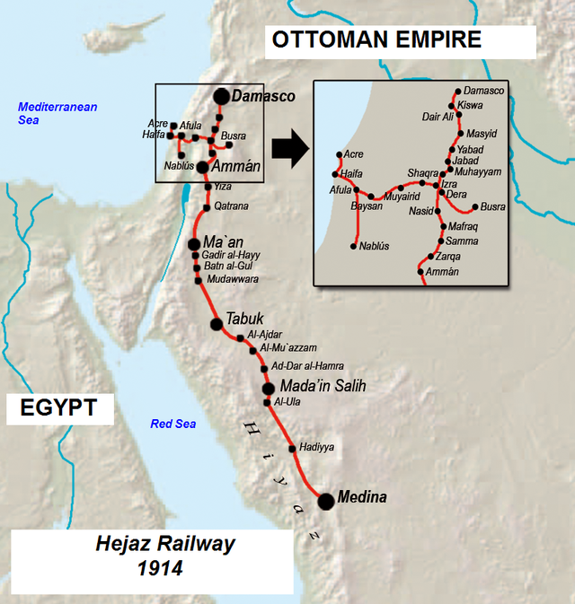
THE HEDJAZ RAILWAY IN 1914

Slide 28
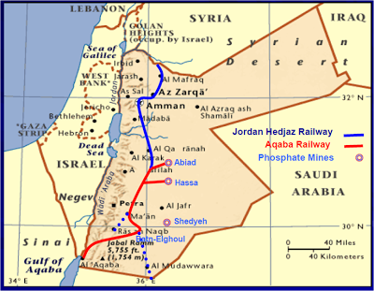
AQABA RAILWAY CORPORATION

Slide 29
THE HEDJAZ RAILWAY
THE HEDJAZ RAILWAY WAS BUILT PRIMARILY FOR PILGRIMS TO VISIT MECCA /MEDINA
THE RAILWAY WAS OPPOSED & ATTACKED FROM THE BEGINNING BY ARAB TRIBES
ONLY SURVIVING SECTION IS THE AQABA RAILWAY IN JORDAN WHICH CATERS TO EXPORT OF PHOSPHATES THROUGH AQABA
BENEFITS OF A RAILWAY ONLY COME IN A STABLE & PEACEFUL POLITICAL ENVIRONMENT

Slide 30
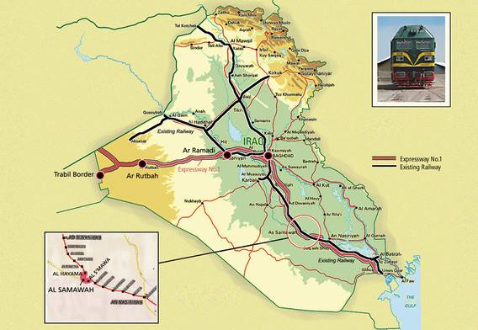
IRAQ RAILWAYS

Slide 31
MOZAMBIQUE RAILWAYS - A UNIQUE ROLE

Slide 32
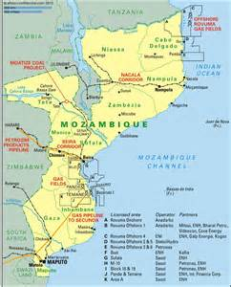

Slide 33
MOZAMBIQUE RAILWAY
THREE INDEPENDENT CORRIDORS
EACH CORRIDOR CATERS TO TRAFFIC FROM LANDLOCKED COUNTRIES TO PORTS
NORTH : MALAWI
CENTRE: ZIMBABWE, MALAWI
SOUTH: ZIMBABWE, SOUTH AFRICA & SWAZILAND
VIRTUALLY NO INTERNAL TRAFFIC
DEVELOPMENT OF SPECIALIZED TERMINALS FOR SUGAR, COAL, CITRUS FRUIT, CONTAINERS
TRAFFIC EFFECTED BY POLITICAL ENVIRONMENT

Slide 34
PROBLEMS FACED BY RAILWAYS BETWEEN 1920-1970

Slide 35
PROBLEMS FACED BY RAILWAYS
MOUNTING COMPETITION FROM ROAD
RAILWAY SYSTEMS RUN DOWN DURING WAR
LOSS IN PROFITABILITY – DECLINE IN OPERATING RATIO
PASSENGER BUSINESS BECAME LOSS MAKING. IN NORTH AMERICA TOTAL DECLINE.
RAILWAY SYSTEMS IN MANY NEWLY INDEPENDENT COUNTRIES WENT INTO DISUSE

Slide 36
RAILWAY REVIVAL 1980’S
SIGNIFICANT TECHNOLOGICAL IMPROVEMENTS
SIGNALLING
TRACK STRUCTURE
ROLLING STOCK
HEAVY HAUL – LONG HAUL
HIGH SPEED RAIL
SUBURBAN SYSTEMS

Slide 37
RAILWAY REVIVAL
REALIZATION AMONG POLICY MAKERS OF RAIL BENEFITS
ENVIRONMENTAL
ENERGY EFFICIENCY
LAND USE
MINIMAL EXTERNAL COST

Slide 38


CO2 EMISSIONS KILOGRAMMES OF CO2 EMISSIONS PER 100 PASSENGER KILOMETRES
Source: UIC Publication – Fast track to Sustainability

Slide 39
ENERGY EFFICIENCY PASSENGER KILOMETRES CARRIED PER UNIT OF ENERGY (1 KWh)
Source: UIC Publication – Fast track to Sustainability

Slide 40
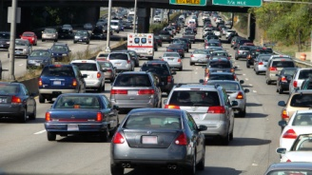
LAND USE
EXPRESSWAY
HIGH SPEED RAILWAY
2 x 3 LANES: 75 m width
2 x 1.7 passengers / car
2 x 4500 cars per hour
2 x 7,650 passengers / hour
Double Track: 25 m width
2 x 666 passengers / train
2 x 12 trains per hour
2 x 8000 passengers / hour
Source: UIC Publication – Fast track to Sustainability

Slide 41
AVERAGE EXTERNAL COST PER TRANSPORT MODE
€
EXTERNAL COSTS INCLUDE: CLIMATE CHANGE, URBAN EFFECTS, NATURE & LANDSCAPE, AIR POLLUTION, NOISE & ACCIDENTS
Source: UIC Publication – Fast track to Sustainability

Slide 42
RAILWAY BUSINESS – DIVERSE NEEDS
FREIGHT
TRAIN LOAD
WAGON LOAD
SMALLS
CONTAINERIZATION - MULTIMODAL
PASSENGER TRAVEL
LONG DISTANCE
INTERCITY
REGIONAL
SUBURBAN
HIGH SPEED RAILWAY
PARCEL
NEED FOR ORGANIZATIONAL RE-STRUCTURING TO CATER TO THESE DIFFERENT BUSINESSES

Slide 43
NEED FOR CHANGE IN APPROACH
RAILWAYS NEEDS TO CHANGE OUTLOOK FROM THAT OF A MONOPOLIST TO AN IMPORTANT TRANSPORT LINK IN THE SUPPLY CHAIN
RAILWAY ALREADY WELL DOVETAILED IN COLLIERY TO POWER HOUSE MOVEMENT
NEEDS TO PROVIDE A SEAMLESS LINK IN THE LOGISTICS CHAIN OF OTHER COMMODITIES

Slide 44
MAJOR RAILWAY SYSTEMS
FREIGHT
USA, CHINA, RUSSIA, INDIA, CANADA, HEAVY HAUL LINES OF AUSTRALIA & SOUTH AFRICA
PASSENGER
INDIA, JAPAN, EUROPEAN RAILWAYS
HIGH SPEED RAILWAYS
JAPAN, CHINA, FRANCE, SPAIN, GERMANY, RUSSIA, ITALY, KOREA …….. 24 COUNTRIES

Slide 45
REVIVING RAIL SYSTEMS IN SOME DEVELOPING COUNTRIES - EXPERIENCE OF PUBLIC PRIVATE PARTNERSHIP

Slide 46
DEFINITION OF PPP
“Provision of a public service or good by a private partner who has been conceded the right (the “Concession”) for the purpose for a specified period of time on the basis of pre-determined revenue stream/s that allow for commercial return on investment/market-determined management fee”
Source: IRITM TRAINING MATERIAL

Slide 47
ANOTHER DEFINITION OF PPP
“Public-Private Partnership (PPP) Project means a project based on a contract or a concession agreement between a Government or statutory entity on the one side and a private sector company on the other side, for delivering an infrastructure service on payment of user charges.”

Slide 48
WHAT PPP IS ABOUT
Private sector involvement in building infrastructure assets and in providing services derived from those assets.
PPP contracts stress long-term service delivery rather than asset creation only.
Services which may be provided to the Government or directly to final consumers.

Slide 49
RANGE OF RAILWAY PPP CONCESSIONS
 | FIXED INFRASTRUCTURE |  | ROLLING STOCK
 | FINANCE & BUILD | OPERATE & MAINTAIN | FINANCE & MAINTAIN | OPERATE TRAIN SERVICES
TRAIN AVAILABILITY CONTRACT | PUBLIC | PUBLIC | PRIVATE | PUBLIC / PRIVATE (Hire from Private)
TRAIN OPERATING CONCESSION | PUBLIC | PUBLIC | PRIVATE | PRIVATE (Access Charge)
INFRASTRUCTURE BUILD CONCESSION | PRIVATE | PUBLIC / PRIVATE | PUBLIC / PRIVATE | PUBLIC / PRIVATE
INFRASTRUCTURE BUILD & OPERATE CONCESSION | PRIVATE | PRIVATE | PUBLIC / PRIVATE | PUBLIC / PRIVATE
INTEGRATED CONCESSION | PRIVATE | PRIVATE | PRIVATE | PRIVATE
Source: Based on Presentation by R. Bullock, World Bank

Slide 50
Global experience

Slide 51
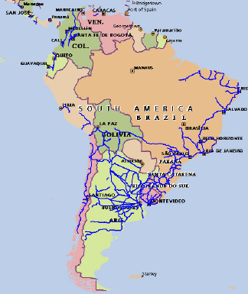
SOUTH AMERICAN RAILWAY SYSTEMS

Slide 52
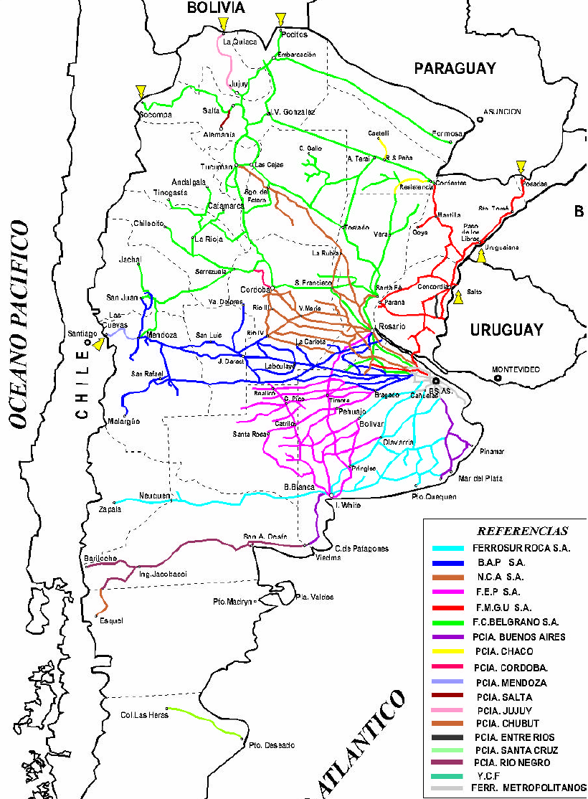
ARGENTINA

Slide 53
SOME FEATURE OF CONCESSIONS
CONCESSIONAIRE GIVEN RIGHTS TO OPERATE & MANAGE THE RAILWAY SYSTEM FOR VARYING PERIODS OF TIME.
OWNERSHIP OF THE INFRASTRUCTURE WITH GOVT.
EACH SYSTEM DIVIDED INTO SEVERAL CONCESSIONS
VERTICALLY INTEGRATED WITH SOME THIRD PARTY OPERATING RIGHTS

Slide 54
PERFORMANCE OF SOUTH AMERICAN CONCESSIONS
MODERATE ECONOMIC SUCCESS
IMPROVEMENT IN EFFICIENCY
INVESTMENT COMMITMENTS NOT MET
STAFF REDUNDANCIES (95,000 TO 15000)
INCREASE IN TARIFFS
CONTINUED NEED FOR SUBIDIES
REDUCTION IN SERVICES
SHRINKAGE OF SYSTEM (35000 TO 8500)
LESSON: PPP MUST BE DRIVEN BY VALUE FOR MONEY PRINCIPLE FOR THE USER

Slide 55
AFRICAN EXPERIENCE
CONCESSION | COUNTRY | YEAR | INFRASTRUCTURE | ROLLING STOCK | OPERATONAL | FINAN-CIAL
SITARAIL | IVORY COAST, BURKINAFASO | 1995 | PUBLIC | PRIVATE | GOOD | AVG.
CAMRAIL | CAMEROON | 1999 | PUBLIC | PRIVATE | FAIR | GOOD
CEAR | MALAWI | 2000 | PRIVATE | PRIVATE
RSZ | ZAMBIA | 2002 | PRIVATE | PRIVATE | AVG. | AVG.
MADARAIL | MADGASCAR | 2003 | PUBLIC | PRIVATE | FAIR | AVG.
TRANSRAIL | SENEGAL/ MALI | 2003 | PRIVATE | PRIVATE | AVG. | POOR
BEIRA RAIL | MOZAMBIQUE | 2005 | PRIVATE | PRIVATE
TRANSGABONAIS | GABON | 2005 | PRIVATE | PRIVATE | FAIR | AVG.
NACALA RAIL | MOZAMBIQUE | 2005 | PRIVATE | PRIVATE | AVG. | POOR
KRC-URC | KENYA UGANDA | 2006 | PRIVATE | PRIVATE
TRC | TANZANIA | 2007 | PRIVATE | PRIVATE | POOR | POOR
SNCC | DR CONGO | 2011 | PUBLIC | PVT./PUB | POOR | POOR
Source: Presentation by Martha Lawrence, World Bank

Slide 56
BRITISH (UK) MODEL
DEPARTMENT OF TRANSPORT
Franchise
Agreements
High Level Output
Statement
ORR
TRAIN OPERATORS
NETWORK RAIL
Track Access Agreements
Association of Train
Train Operating Cos.
(ATOC)
Rolling Stock
Leasing Companies
(ROSCOS)
Rail Safety and
Standards Board

Slide 57
JAPANESE PRIVATIZATION
JNR ESTABLISHED 1949 – ‘PUBLIC ENTERPRISE’
DECLININIG MKT. SHARE, LOSSES, MOUNTING DEBT
JNR BECAME A MONOLITHIC ORGANIZATION WITH A WORKFORCE OF 400,000
REFORMS
REGIONAL DIVISION
SEPERATION OF INFRASTRUCTURE & TRAIN OPERATION

Slide 58
JAPANESE REFORMS
SIX PASSENGER RAILWAYS FORMED BY REGION
FOCUS OF EACH ON REGIONAL OPERATION. SOME LONG DISTANCE SERVICES
2 NON OPERATING COMPANIES VIZ. RAILWAY TECHNICAL RESEARCH INSTITUTE & RAILWAY INFORMATION SYSTEMS CO. LTD.
COMMON TICKETING RULES INTEGRATED RESERVATION

Slide 59
JAPANESE RAIL REFORM
INITIALLY IN 1987 OWNERSHIP OF ALL OPERATING COMPANIES WITH GOVT.
BY 2006 SHARES OF THREE COMPANIES OWNED BY PUBLIC VIZ JR-EAST, JR CENTRAL & JR WEST
OWNERSHIP OF REMAINING COMPANIES, JR KYUSHU, JR SHIKUKO, JR HOKKAIDO & JR FREIGHT WITH JR CONSTRUCTION, TECHNOLOGY CO. A STATE INSTITUTION.

Slide 60
JAPANESE RAIL REFORM
DEBT BURDEN TRANSFERRED PARTIALLY JR EAST, JR WEST & JR CENTRAL
REMAINING DEBT TRANSFERRED TO JNR SETTLEMENT CORPORATION
NATIONWIDE DRIVE TO EMPLOY SURPLUS STAFF.
NEW COMPANIES EMPLOYED 30% MORE THAN REQUIREMENT, 71,000 STAFF RE-EMPLOYED ELSEWHERE OR RETIRED
40% OF DEBT OBLIGATION & 25% STAFF REDUCED

Slide 61
THANK YOU

