Slide 1

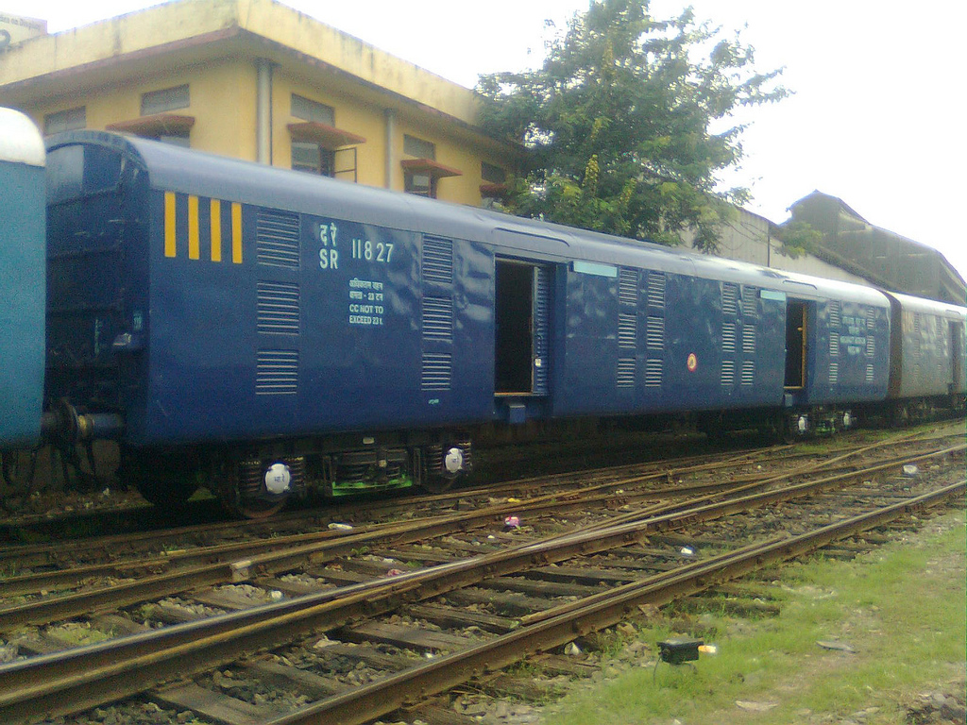
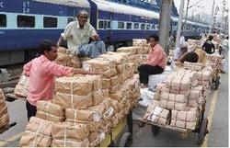
Indian Railways Parcel Business
CEP
B2C
E-Commerce

Slide 2
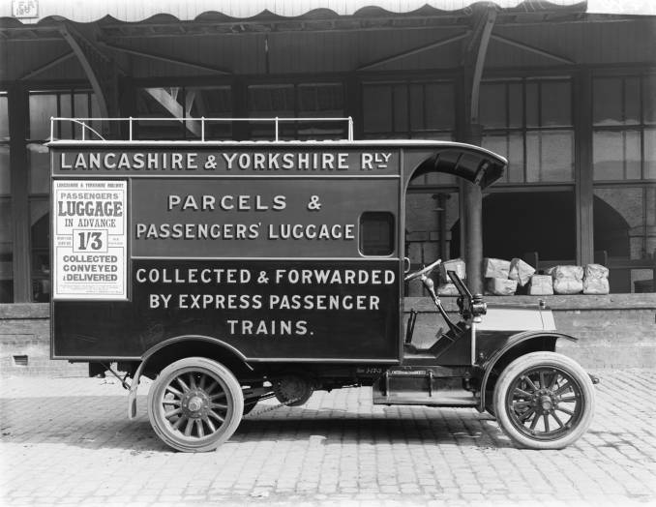

Slide 3
Indian Railways’ Earnings
(data are of Year 2016 and approximate)
Rs.1,60,000 Cr
65% is Freight
1.2 % is Parcel
90% from Bulk Commodities
5% of Freight earnings from Container traffic

Slide 4
How do Indian Railways carry Parcels?
Assistant Guard Cabins (AGC)
Brake Vans (SLRs)
Parcel Vans (VPU/VPH)
Special Parcel Trains
Freight Wagons (BCN)
Special Wagons (Milk Tank)
Refrigerated Wagons/Coaches

Slide 5
Booking of Parcels
Non-Leased
Leased

Slide 6
Non-Leased Parcel: Concerns
Manual handling – Pallet and Container solutions ?
Non-availability of space
Over-carriage
Prior information
Segregation for OD
Damage during transit

Slide 7
Parcel Management System (PMS)
“Parcel Management system is implementation of IT and computerizing the work of Booking, Loading, Unloading, tracking, tracing, delivery and internet based enquiry. As per the main features of parcel management system, booking, weighment and cash payment can be done on single window. The use of technologies like Bar-coding and tracking facility improves the management of parcel traffic. Customer can track their parcel through Parcel and Luggage Tracking online system available on website address www.parcel.indianrail.gov.in.”
http://www.indianrailways.gov.in/railwayboard/uploads/directorate/cis/downloads/ParcelManagementSystem.pdf

Slide 8
Comprehensive Parcel Leasing Policy, 2014
http://www.indianrailways.gov.in/railwayboard/uploads/directorate/traffic_comm/Frght_Mktg_2k14/FM_06_2014.pdf
http://www.indianrailways.gov.in/railwayboard/uploads/directorate/traffic_comm/Freight_Marketting_2016/FM_Draft_140116.pdf

Slide 9
Special Parcel Train Operator (SPTO) Scheme
http://www.indianrailways.gov.in/railwayboard/uploads/directorate/traffic_comm/Frght_Mktg_2k14/FM_23_14.pdf

Slide 10
Policy on Leased Parcel Cargo Express, 2007, 2016
http://www.indianrailways.gov.in/railwayboard/uploads/directorate/traffic_comm/Freight_Marketting_2016/FM_140116.pdf

Slide 11
Parcel rates
http://www.indianrailways.gov.in/railwayboard/view_section.jsp?lang=0&id=0,6,335

Slide 12
Indian Railways:
Scales of Parcel Rates
Scale | Rate (Rs.) for 1-10 Kg for 1-50 Km | Rate (Rs.) for 1-10 Kg 51-60 Km
LUGGAGE (L) | 4.43 | 5.06
RAJDHANI (R) | 3.93 | 4.22
PARCEL (P) | 2.10 | 2.25
STANDARD (S) | 1.31 | 1.41

Slide 13
Rates Comparison
Railways cargo is almost 50% cheaper than air-cargo & 90% of the existing online orders are currently being shipped via air-cargo!

Slide 14
Parcel Earning Projections
Year | Earnings (Crores) | % growth
2013-14 | 1827.6 | 11.7%
2014-15 | 2002.23 | 10.0%
E-tail business is growing at over 50% per annum.
IR’s Parcel Business is incurring LOSSES!

Slide 15
Morgan Stanley Research, 2015
The World Bank estimates that India's logistics costs are 2-3x the best practice benchmark costs, hurting India's manufacturing competitiveness. We believe that the key reason for this is the underinvestment in Indian Railways – with budget allocation vs. roads significantly lower than global standards. Rail is a significantly cheaper mode of transport than roads, yet the share of roads in Indian freight movement is >1.5x that of the railways, owing to the congestion on the rail network and poor policies
http://www.indianrailways.gov.in/Morgan%20Stanley%20Report%20on%20Indian%20Railways.pdf

Slide 16
Indian Railways:White Paper, 2015
http://www.indianrailways.gov.in/railwayboard/uploads/directorate/finance_budget/Budget_2015-16/White_Paper-_English.pdf

Slide 17
Excerpts of Indian Railways Budget 2016-17
104. Non-Fare Revenues:
e. Overhaul of Parcel business: We plan to liberalize the current parcel policies including opening the sector to container train operators to effect a quantum jump in IR’s share of the national CEP (Courier, Express and Parcel) market. Door to door connectivity is especially important for this market segment and we will take all steps necessary to expand our service offerings specially to growing sectors such as e-commerce. We will also initiate a pilot project for online booking of parcels.

Slide 18
Excerpts of Indian Railways Budget 2016-17
Tariff rationalisation
99.The current tariff structure of IR has led to out-pricing of our services in the freight market. A review of tariff policy will be undertaken to evolve a competitive rate structure vis a vis other modes, permit multi-point loading/unloading and apply differentiated tariffs to increase utilization of alternate routes. The possibility of signing long term tariff contracts with our key freight customers using pre-determined price escalation principles will be explored which would provide predictability of revenues to IR and of costs to our customers.

Slide 19
Excerpts of Indian Railways Budget 2016-17
Building terminal capacity
100. Inadequacy of warehousing and transportation facilities is also one of the causes that that keep potential customers away from Page 31 of 46 the Railways. In order to complete the chain of transportation, it is proposed to develop Rail side logistics parks and warehousing. These logistic parks and warehouses would be created in PPP mode to bring the required efficiency and investment but also help attract greater traffic to the Railways. With the coming in of TRANSLOC, the Transport Logistics Company of India, we will be witness to a paradigm shift in our role as a national logistics provider. The focus will be on providing last mile connectivity for freight business and significant reduction in logistic costs. At least 10 goods sheds will be developed by TRANSLOC in 2016-17. To capture the automobile traffic, we will soon inaugurate India’s first rail auto hub in Chennai.

Slide 20
Excerpts of Indian Railways Budget 2016-17
101. This push on rail side warehousing would also encourage development of cold storage facilities on vacant land near freight terminals. Local farmers and fisherman would be given preferential usage of the facility. A policy in this regard would be issued in the next 3 months.

Slide 21
CEP (Courier, Express, Parcel)
Urgent, high value low volume, time sensitive, perishable
Bottom line: Fast and reliable delivery
Small packages: 50-70 Kg
International (steady) and Domestic (Hike) markets
Traditionally B2B; now also B2C and C2C
Logistics pattern: first mile, line haul, last mile
Role of e-commerce

Slide 22
Liked by Stakeholders
“Railways would extend logistic support to various ecommerce companies by providing designated pick-up centres at identified stations.”
(Hon’ble Minister for Railways, 2014)

Slide 23
CEP
Global CEP market at CAGR of 3.42 % in 2014-19 (technavio’s forcast)
CEP Market:
Driver – Domestic E-Commerce business
Challenge – Competition in Market
Trend – Rise of Inter-modal logistics

Slide 24








Traditional CEPs

Slide 25
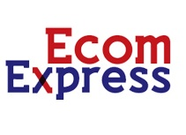


New Gen CEPs

Slide 26






New Start ups
Pickrr
Shipsy
Parcelled
Daak Ninja
Ship Tickr
Pigen

Slide 27
E-Commerce
Global B2C sales: $1.7 trillion (2015) – $2.3 trillion (2018) Annual growth rate = around 15%
Asia-pacific and China with India – emerging fast
India’s market - $100 billion by 2020 (Golden Sachs)
Leading ones: Flipcart, Amazon, Snapdeal

Slide 28
Why E-Commerce?
Many benefits
Many players
New operation pattern – Reverse logistics
3PL and more…
“The global 3PL market reached $750 billion in 2014, and grew to $157 billion in the US; demand growth for 3PL services in the US (7.4% YoY) outpaced the growth of the US economy in 2014. As of 2014, 80 percent of all Furtune 500 companies and 96 of the Fortune 100 used some form of 3PL services.” (source: Wikipedia)

Slide 29
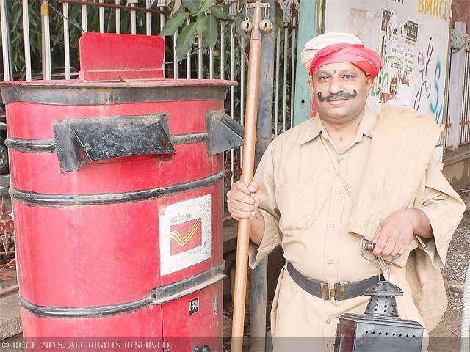
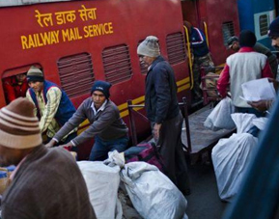
With e-commerce push, India Post parcel revenue soars 37%
(PTI Jul 12, 2015, 03.51PM IST)
(As part of initiatives to leverage the e-commerce sector, India Post has forged tie ups with Snapdeal, Amazon, Paytm and Yepme for parcel delivery.)

Slide 30
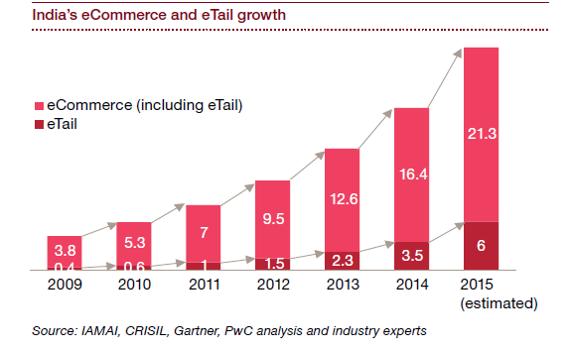
Growth trends of e-Commerce

Slide 31
Relevance of e-Commerce to Railways
e-commerce business by 2020 will be $100 Billion (from $2.9billion in 2013) as per Morgan Stanley report.
e-Tail which involve transportation of goods constitute about 6% of e commerce business.
Logistics component of value is about 10%.
Core competence of Railways is Transportation
IR’s parcel business at present is about Rs2000 Cr.
Railway Needs to Claim its Share
(source: AMP Project/NAIR)

Slide 32
SWOT: Railways as Logistics Solution to e-Commerce: Strengths
Established transporter
Daily interaction with about 25 million customers
Railway can be easy pick up & delivery points at Stations
Established Railway PSUs like ITRCTC (already doing e-Commerce), CONCOR
Wide pan India presence
Bulk movement of goods for B2B commerce
Connectivity with the hinterland and smaller business hubs
Cost effective & speedy long distance transportation
Located in business hubs in most cities
Unrestricted interstate movement of goods
(source: AMP Project/NAIR)

Slide 33
SWOT Analysis: Weaknesses
Centralization of business related decision-making.
Poor quality of customer interface at the booking points
No assured service of safe delivery of consignments
Poor handling of goods at loading and unloading points
Inadequate terminal facilities like warehousing, stacking etc.
Lack of long term partnership with potential customers
No monitoring or tracking system of consignments
Theft of goods and lack of security at terminals
Tardy and lengthy process of settlements of claims
Limitations in availability and customization of rolling stock
(source: AMP Project/NAIR)

Slide 34
SWOT Analysis: Opportunity
High growth rate of e-commerce or e-tailing in India
Low cost of entering e-Commerce
Poor condition of roads in the hinterlands
Limited capacity of airline cargo
Expansion of e-tailing in Tier-2 and Tier-3 cities where Railways has good connectivity
Bulk movement of goods booked by e-commerce companies
(source: AMP Project/NAIR)

Slide 35
SWOT Analysis: Threats
Loss of traffic to other modes of transport through e-Commerce
Cost effective road transport
End to end delivery by Road transport
Expansion and improvement of road network
Preference of e-commerce companies for other mode of transport
Government Regulations
(source: AMP Project/NAIR)

Slide 36
Business e-Commerce options for Railways
Model 1:
(Business as usual) Limited Logistics solution to e-Commerce
  Web portal for booking of vehicles/ warehousing space to be operated by IR.
  Transportation + temporary storage (Warehousing) by Railways
  Front & Back end logistics like transportation from supplier of goods upto warehouse by e-Commerce companies
  Warehousing at origin & destination by company
  (source: AMP Project/NAIR)

Slide 37
Model-1: Limited Logistic Solution
  Long term agreement between IR & e-Commerce company for assured supply of vehicles & traffic respectively
  Handling at loading and unloading points to be responsibility of e-commerce companies
  Safety & security of goods during handling at loading & unloading points shall be responsibility of e-commerce companies
  IR shall allocate space on SLRs/Lease VPUs
  (source: AMP Project/NAIR)

Slide 38
Model-1:Limited Logistics Solution
MANUFACTURERS
TERMINAL -O
TERMINAL -D
WAREHOUSE
WAREHOUSE
CUSTOMERS
(source: AMP Project/NAIR)

Slide 39
Limitations of model -1
Mainly addresses the transportation aspect and not the complete logistics issue.
Substantial quantum of traffic especially the long distance e-Commerce traffic already being carried by IR thus may not lead to net increase in traffic volumes
Conservative approach to business which may not provide adequate opportunity to increase IR’s business.
Does not harnesses the available strengths of IR in form of PSUs with competence in e-Commerce and complete logistics.
(source: AMP Project/NAIR)

Slide 40
Model 2: Business Option- Railways entry into e Commerce
IR
IRCTC
CONCOR
So far IR unable to attain expected growth in parcel business.
IRCTC already in e-Commerce
CONCOR already providing complete logistics solution for many companies
(source: AMP Project/NAIR)

Slide 41
Model 2: Creating Synergies
IR
IRCTC
CONCOR
IR can offload parcel business to IRCTC who in partnership with CONCOR can engage in e-Commerce business
JV between IRCTC & CONCOR with equity participation of IR.
(source: AMP Project/NAIR)

Slide 42
Model-2: Creating Synergies contd.
JV to have full freedom to make all business decisions
JV to have obligation to pay dividend to IR
JV shall operate all components of e-Commerce viz selling of goods through web portal, provide logistics, banking transactions
The e-Commerce entity shall also utilise existing warehouses of CONCOR or develop new warehouses.
It would also provide necessary insurance and compensation of the goods to the customers in case of damage and non-delivery
(source: AMP Project/NAIR)

Slide 43
Points to appreciate…
Railways is uniquely placed in the transportation and logistics business
Railways is reasonable – charge-wise and otherwise too
Railways have wide network and connectivity
Railways do business too
Railways need to realize its role as a key link of the whole logistics chain

Slide 44
Thank You

